Slide 1
OŠ MATIJE GUPCA GORNJA STUBICA

Slide 2
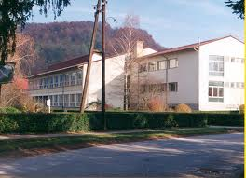
HISTORY OF THE SCHOOL
The first school in Gornja Stubica was built in 1863.
In 1970 the students and teachers moved to the new school building. The school changed its name into the Primary School "Matija Gubec“

Slide 3
From1996 the school has been included in the GLOBE project. We were the first elementary school in the Republic of Croatia, which began sending data to the GLOBE center in the United States.

Slide 4
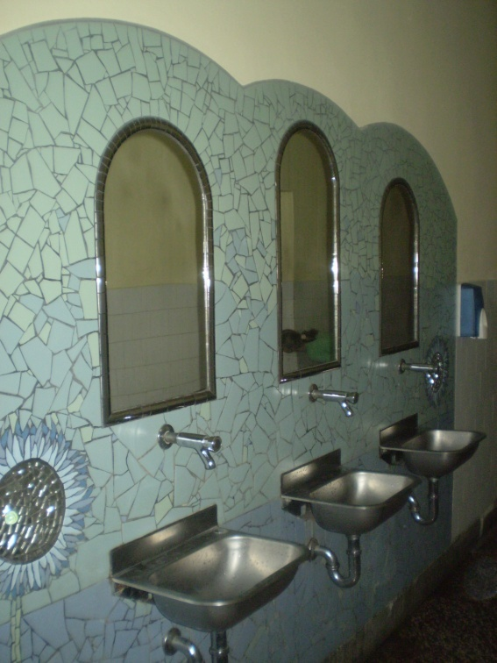
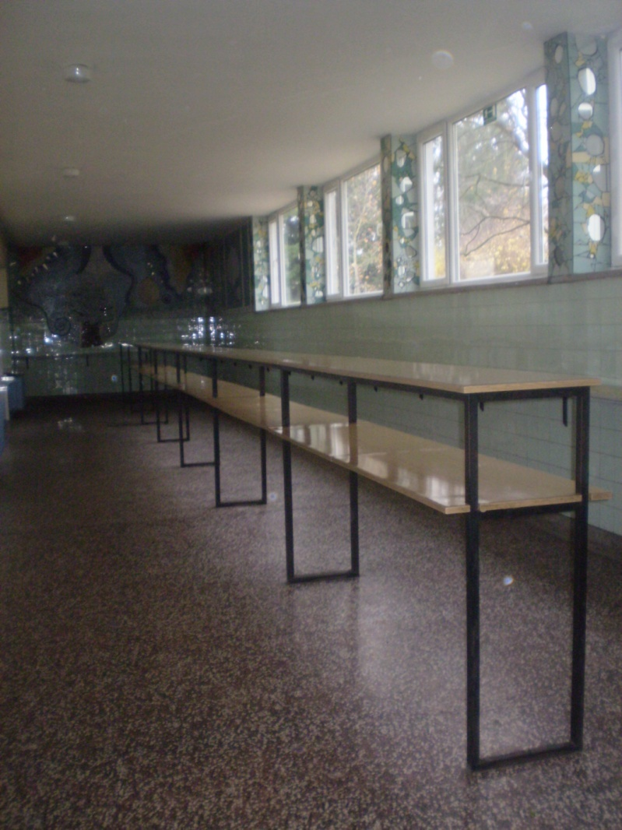
We have one kitchen where we eat healthy and delicious food every day

Slide 5
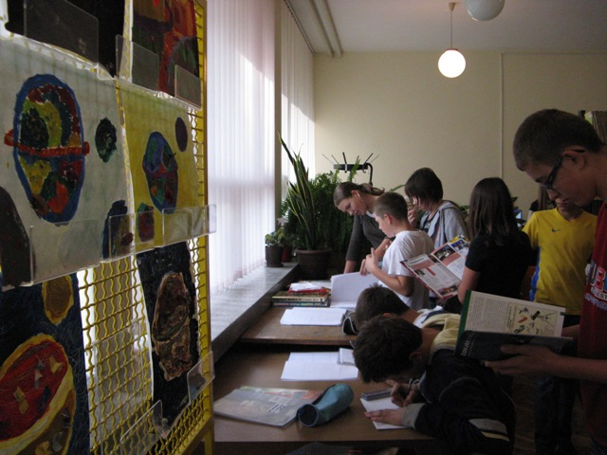
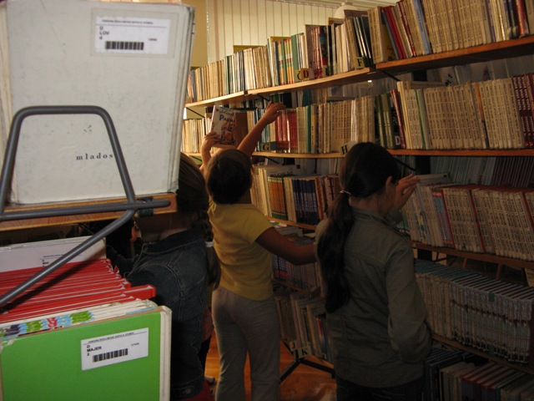
INSIDE OUR SCHOOL
On the ground floor there is the gym, classrooms for the Croatian language, art classroom and the library. There are a lot of books and magazines there.

Slide 6
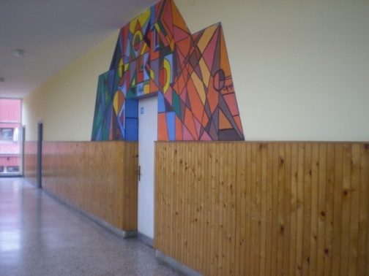
the first floor
On the first floor there are science, mathematics, history and chemistry classrooms and a computer room.

Slide 7
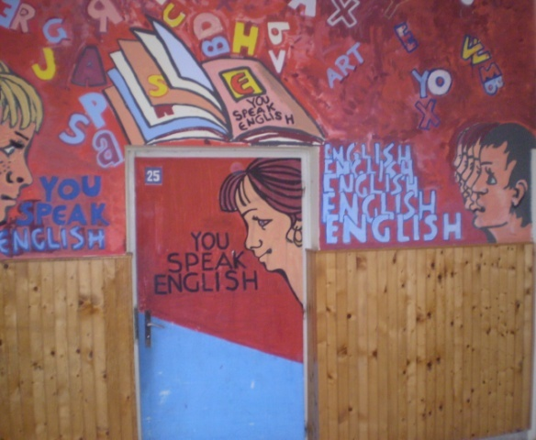
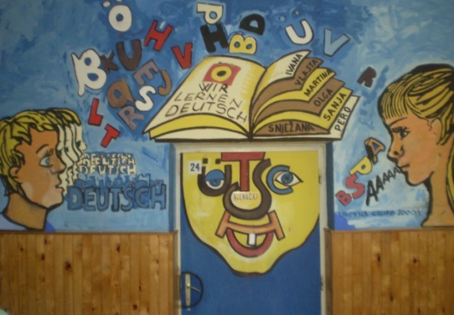
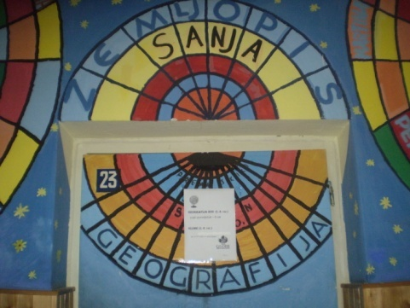
the second floor
On the second floor there are the classrooms for geography and for foreign languages. We learn English and German.

Slide 8
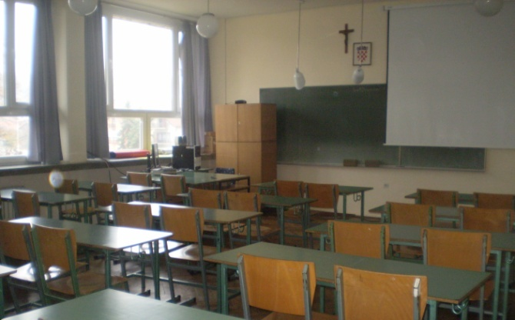
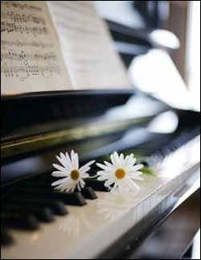
the attic
In the attic there is the music, mathematics, Croatian, and the preschool classroom.

Slide 9
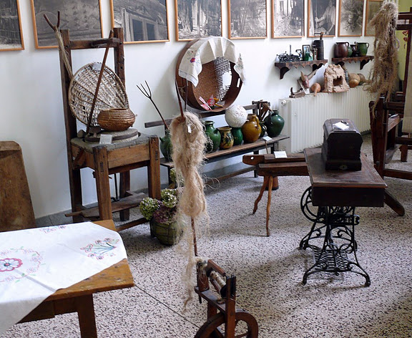
TRADITIONAL
customs
and objects

Slide 10
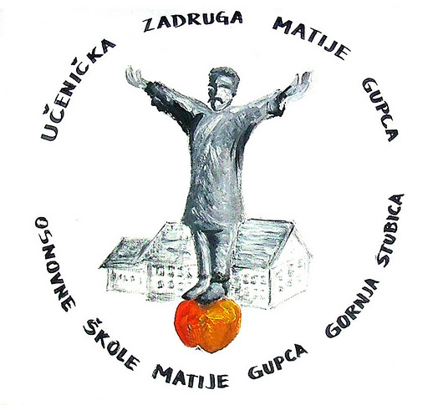
school co-operatives
Fruit group
Ethnographic
Photographic Section
Section of Fine Arts
Collectors of medical plants
Embroiderers
Klinček section
Section Drijenčeki

Slide 11
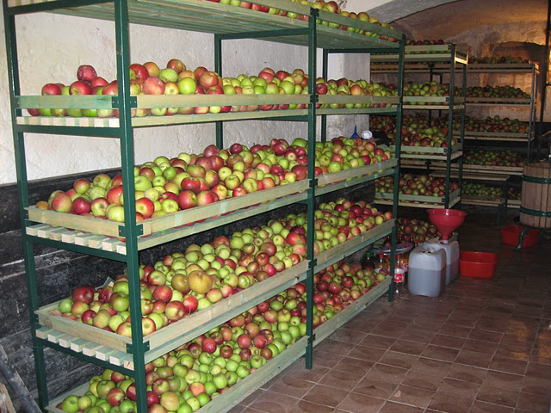
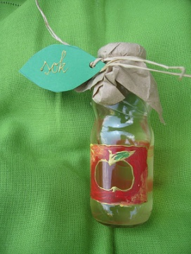
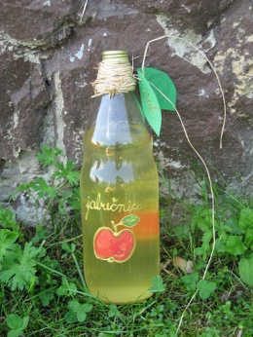
FRUIT GROUP
Products:
- produces apple chips, sells apples and apple cider vinegar products. The orchard extends to 3272 m2, where 270 apple trees have been planted.

Slide 12
Ethnographic
- collects meteorological folk sayings, antique items, old recipes, folk beliefs of the people living in our hometown, children's games, toys, songs and dances.

Slide 13
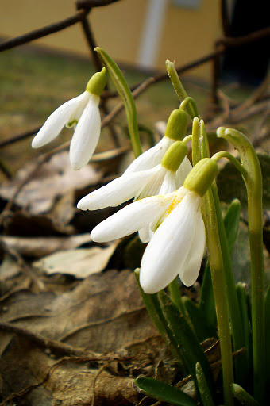
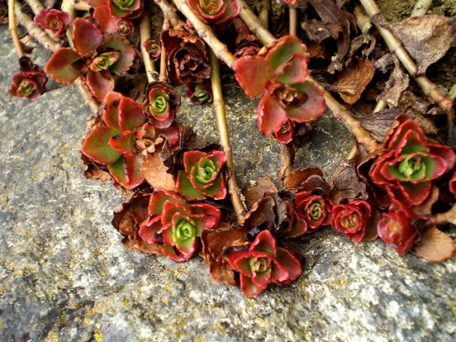
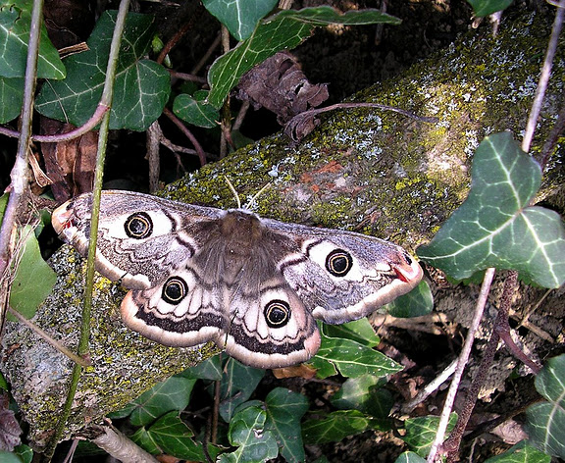
Photographic Section
Our school has the photography department which keeps track of all the events related to school and around it.

Slide 14
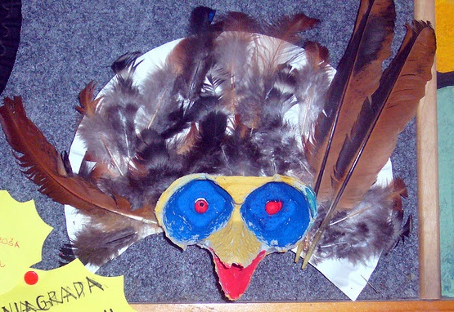
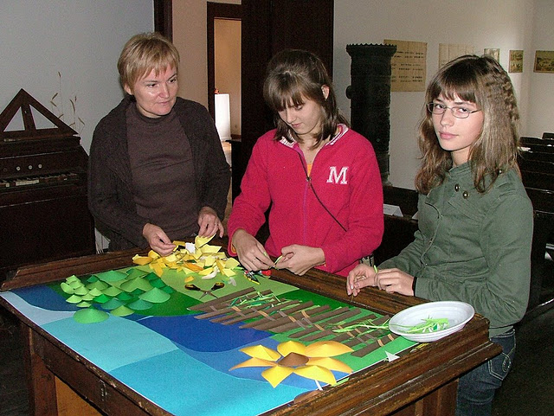
Section of Fine Arts
Deals with aesthetics of our school. Together with the ethnographic section participates in the aesthetic arrangement of ethno - collection of various events and performances in school and participates in monitoring the school co-operatives at festivals and concerts and arranges their stands. Prepares labels and packaging for the products of other sections.

Slide 15
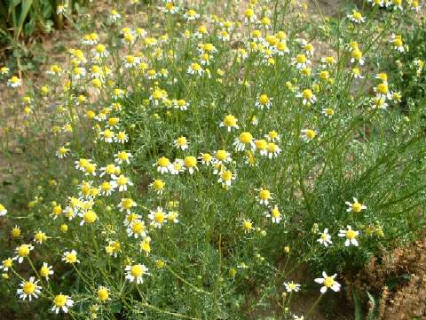
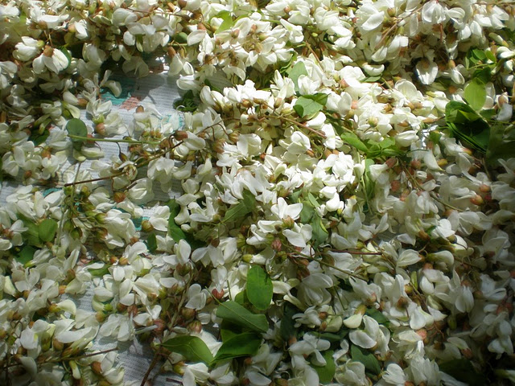
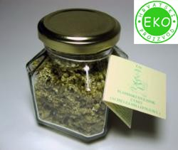
collectors of medical plants
Members of this section collect herbs for tea: elder, chamomile, mint, walnut, nettle, linden, rosemary, acacia, rose petals, marigold and pomegranate. Herbs are dried and packed in the school premises. Tea is our school specialty which has a unique flavor.

Slide 16
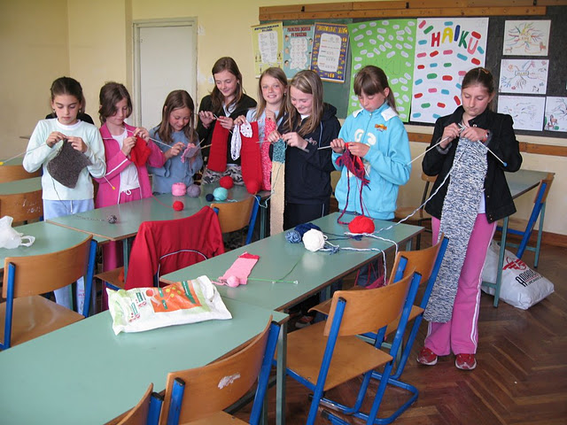
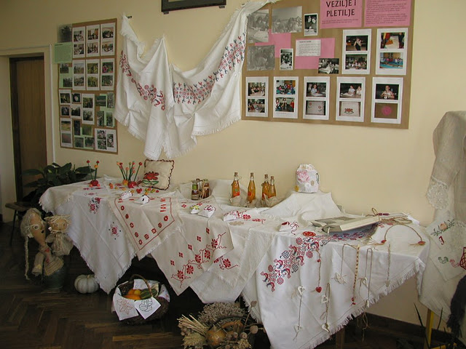
Embroiderers

Slide 17
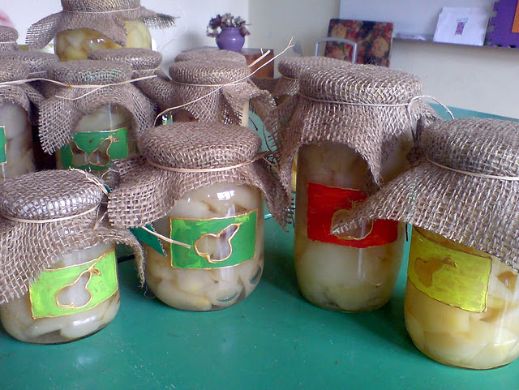
Klinček
section
Section deals with the production of pears and apples compote, honey, dandelion, elderberry jam, and the fostering of traditional flower beds. Artistic branch deals with making packaging for the compote, honey and jam.

Slide 18
Section Drijenčeki
Section deals with the production of marmalade drenjina in a natural way. Their aim is to investigate the medical properties of drenjina and other edible wild fruits disadvantaged and develop awareness of everyday use drenjina as a medicinal food.

Slide 19
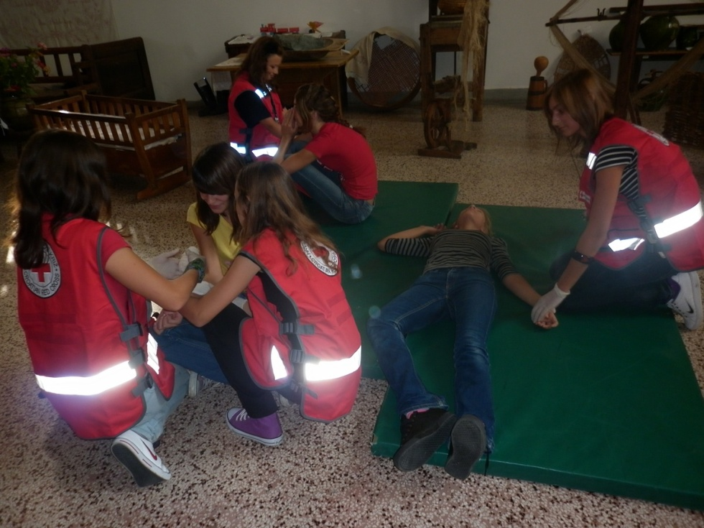
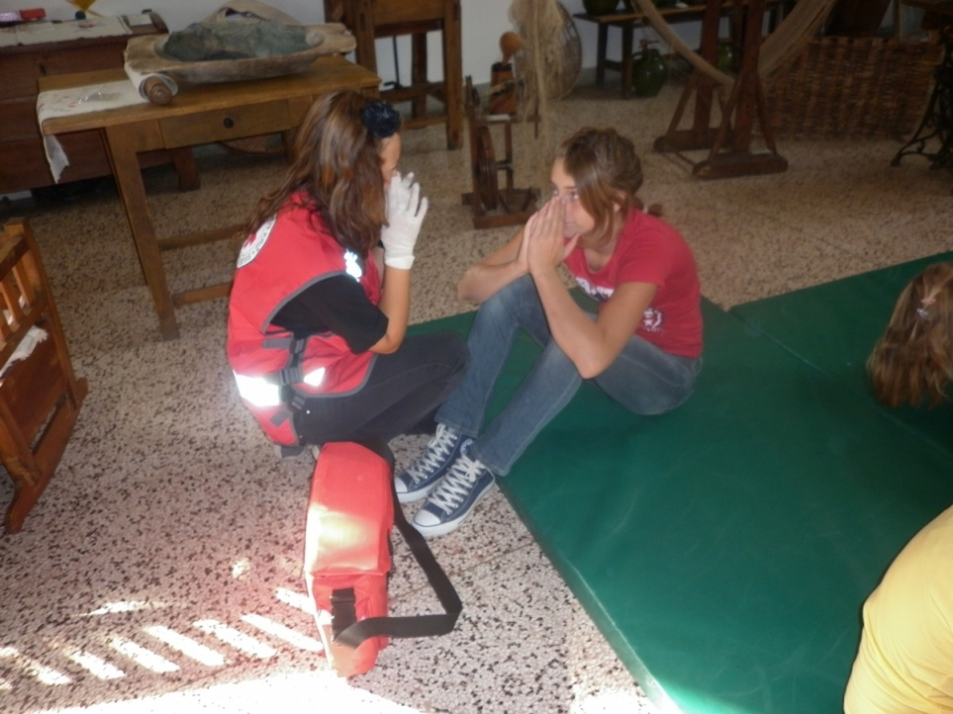
RED CROSS
In our school there are a lots of extracurricular activities such as Red Cross Group.

Slide 20
LIPIN PUČKOŠKOLAC
Lipin pučkoškolac; our school newspaper where you can read all the school news…

Slide 21
Made by:
Manda Klanjčić
Izabela Lukina
Ivana Kosec
Marta Španec
Sara Drempetić
Antonela Čupar
8.A

